Slide 1
Data Curation of Air Quality Data
Group 25

Slide 2
Motivation

Slide 3
Data Sources
Air Quality for City of New York Dataset by Government of US (16218 x 12)
Air Quality for City of New York from Kaggle (5100 x 13)

Slide 4
Data Quality Issues
Inconsistent date formats
Missing values
Outliers / Bad measurements

Slide 5
Data Integration Challenges
Creating mappings
Standardizing column names
Handle different data types among columns
Handle duplicate rows

Slide 6

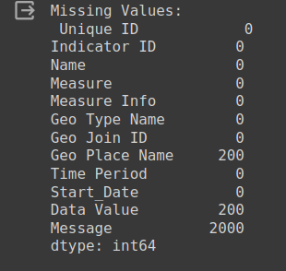
Identifying Missing Values

Slide 7

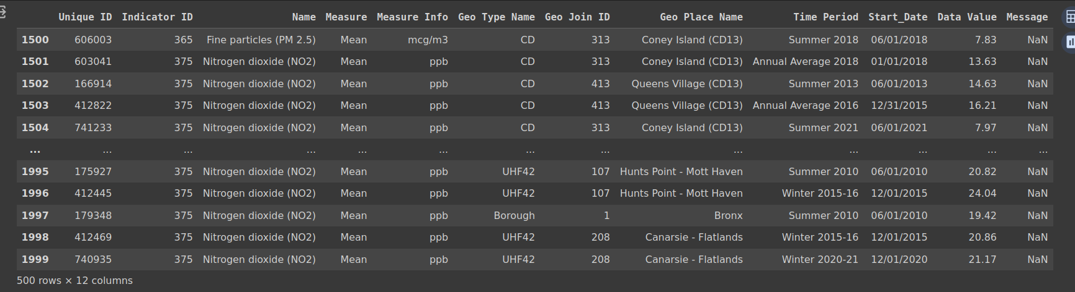
Identifying Duplicate Rows

Slide 8


Handling Duplicate & Missing Values

Slide 9
Checking unique values for categorical inconsistency

Slide 10
Addressing Inconsistencies

Slide 11
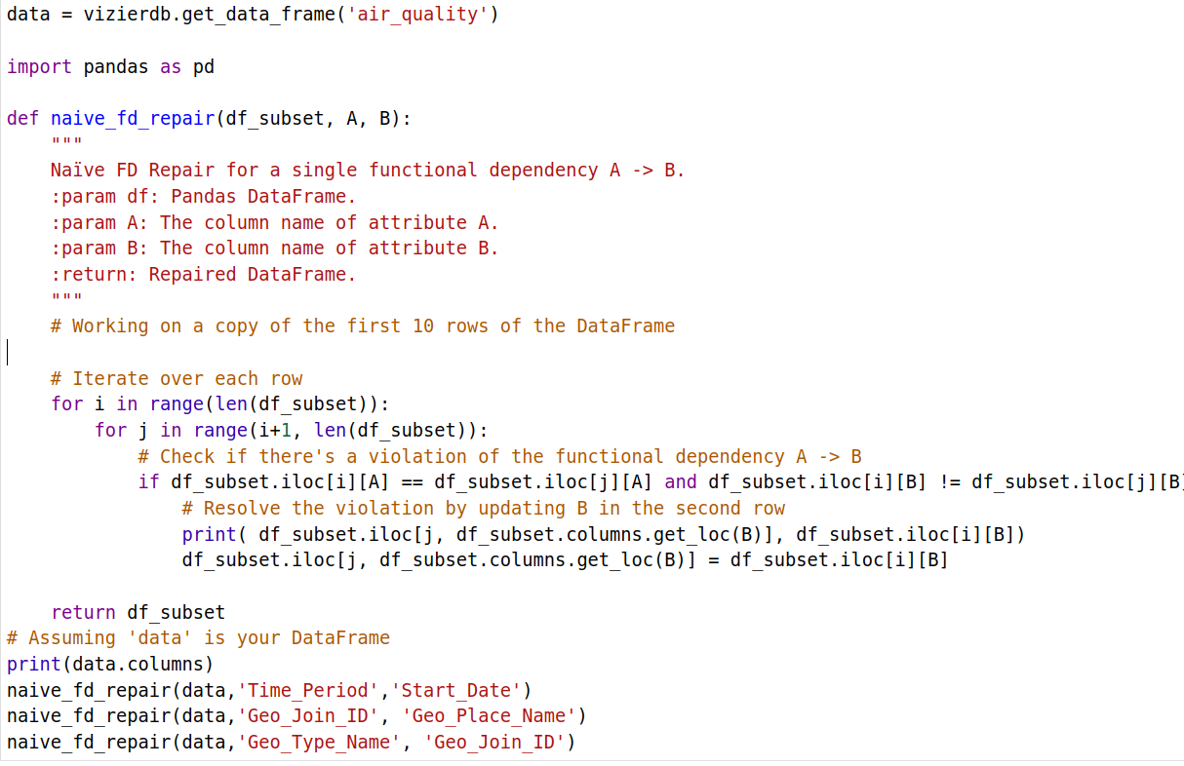
Data Cleaning and Functional Dependency Repair in Python

Slide 12
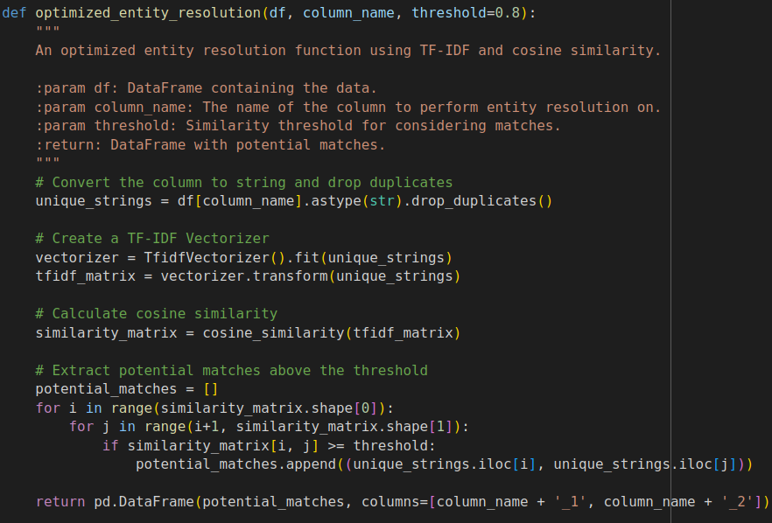
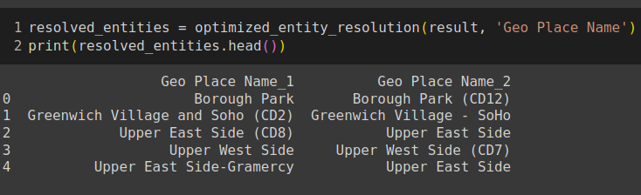
Simple Entity Resolution in Python

Slide 13
Thank you!

